Slide 1








v
Box Model in CSS
Cascading Style sheet(CSS)
Presented by :- Sinchana A B

Slide 2
v
What is the CSS box model
The CSS box model is the fundamental concept that define how elements are displayed on a webpage. It consist of content padding border and margin,

Slide 3
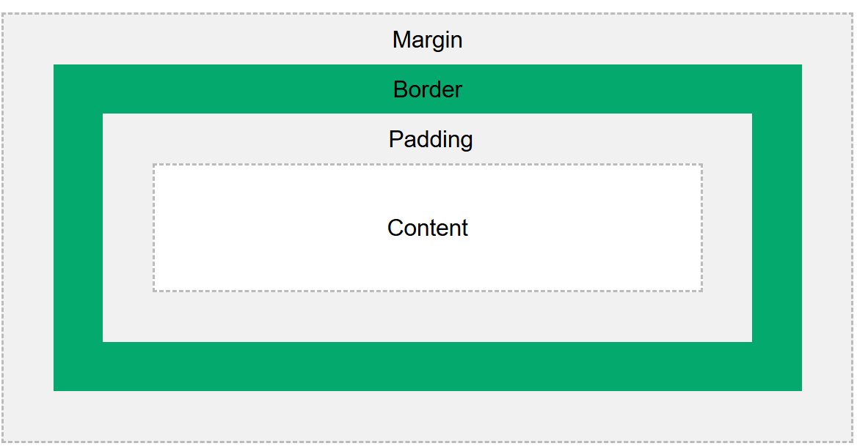
Component Box model
Content - The content of the box, where text and images appear
Padding - Clears an area around ththee content. The padding is transparent
Border - A border that goes around padding and content
Margin - Clears an area outside the border. The margin is transparent

Slide 4
Demonstration of box Model
<head>
<style>
div {
background-color: lightgrey;
width: 300px;
border: 15px solid green;
padding: 50px;
margin: 20px;
}
</style>
</head>
<body>
<h2>Demonstrating the Box Model</h2>
<div>This text is the content of the box. We have added a 50px padding, 20px margin and a 15px green border. </div>
</body>
</html>

Slide 5
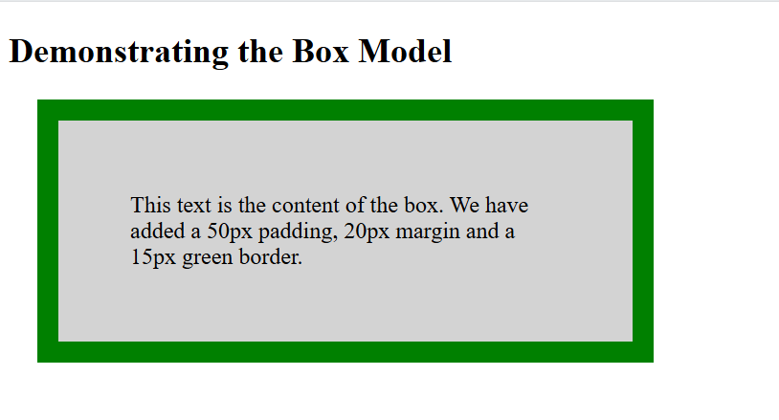
Output for example

Slide 6
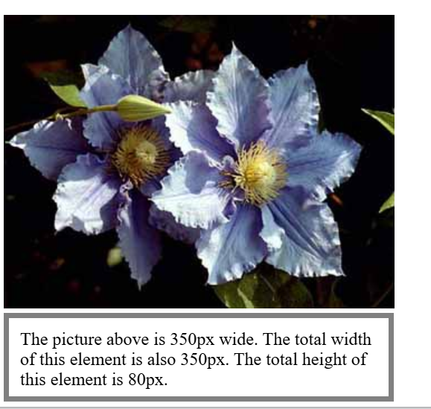
Width and height of element
div { width: 320px; height: 50px; padding: 10px; border: 5px solid gray; margin: 0;
}
<body>
<img src="klematis4_big.jpg" width="350" height="263" alt="Klematis">
<div>The picture above is 350px wide. The total width of this element is also 350px. The total height of this element is 80px.</div>
</body>

Slide 7
Calculation of width and height
320px (width of content area) + 20px (left padding + right padding) + 10px (left border + right border) = 350px (total width) 50px (height of content area) + 20px (top padding + bottom padding) + 10px (top border + bottom border) = 80px (total height)

Slide 8
Summary
The CSS Box Model is essential for layout and spacing in web design, understanding its components helps in precise elemrnt styling

Slide 9
THANK YOU

